Slide 1
Breast Cancer Case

Slide 2
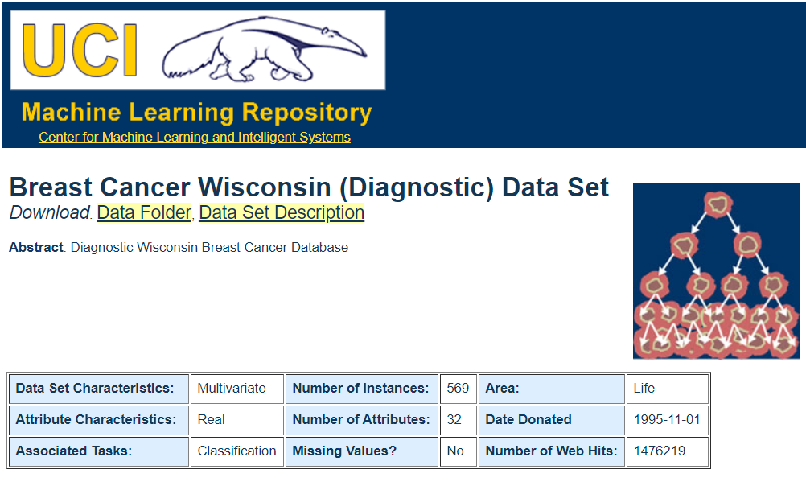

Slide 3
Table of Contents
01
02
Introduction & Descriptive Statistics
Analysis & Interpretation of variables
03
04
Interpretation of Findings
Recommendations

Slide 4
Introduction
Global statistics suggests that Breast Cancer is 2nd Leading cause of Cancer death among Women.
It occurs due to abnormal growth of the cells in Breast tissues which is called tumour.
About 1 in 8 U.S. women (about 13%) will develop invasive breast cancer over the course of her lifetime.
Such devastating statistics encouraged us to create awareness and submit our analysis on such critical issue to stop / reduce the new cases.

Slide 5
Intro. Continuation
A tumour can be classified as either Malignant (cancerous) or Benign (non-cancerous).
The current dataset has different variables that are derived from a digitized image of a fine needle aspirate (FNA) of a breast mass. They describe characteristics of the cell nuclei present in the image.
There are total 30 features (independent variables). We aim to observe which features are most helpful in predicting Malignant (M) or Benign(B) Cancer and to see general trends that may aid us in our work.

Slide 6
01
Descriptive Statistics (Identification of Variables)

Slide 7
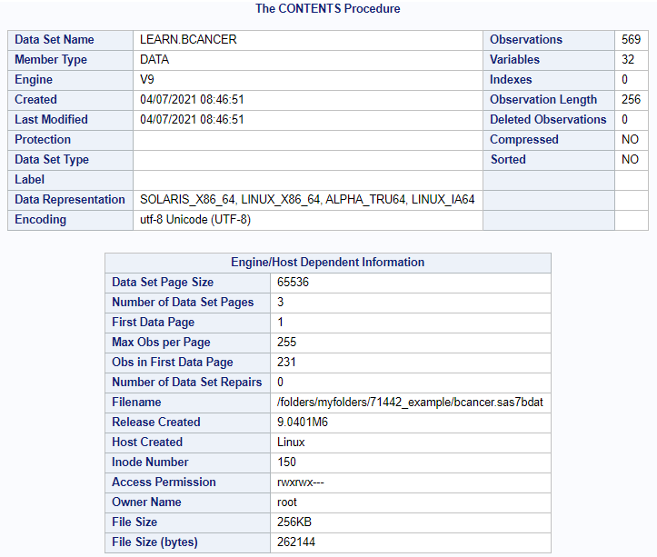
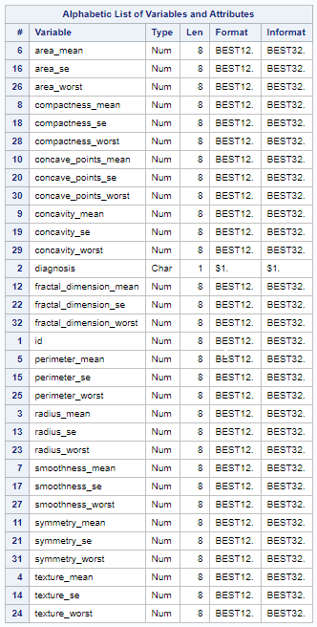

Slide 8
Variable Identification
Variables in Creation Order
# | Variable | Type | Len | Description
1 | id | Num | 8 | #ID number
2 | diagnosis | Char | 1 | The diagnosis of breast tissues (M = malignant, B = benign)
3 | radius_mean | Num | 8 | mean of distances from center to points on the perimeter
4 | texture_mean | Num | 8 | standard deviation of gray-scale values
5 | perimeter_mean | Num | 8 | mean size of the core tumor
6 | area_mean | Num | 8 | mean size of the area of the tumor
7 | smoothness_mean | Num | 8 | mean of local variation in radius lengths
8 | compactness_mean | Num | 8 | mean of perimeter^2 / area - 1.0
9 | concavity_mean | Num | 8 | mean of severity of concave portions of the contour
10 | concave_points_mean | Num | 8 | mean for number of concave portions of the contour
11 | symmetry_mean | Num | 8 | mean for symmetry
12 | fractal_dimension_mean | Num | 8 | mean for "coastline approximation" - 1
13 | radius_se | Num | 8 | standard error for the mean of distances from center to points on the perimeter
14 | texture_se | Num | 8 | standard error for standard deviation of gray-scale values
15 | perimeter_se | Num | 8 | standard error for the size of the core tumor
16 | area_se | Num | 8 | standard error for the area of the tumor
17 | smoothness_se | Num | 8 | standard error for local variation in radius lengths
18 | compactness_se | Num | 8 | standard error for perimeter^2 / area - 1.0
19 | concavity_se | Num | 8 | standard error for severity of concave portions of the contour
20 | concave_points_se | Num | 8 | standard error for number of concave portions of the contour
21 | symmetry_se | Num | 8 | standard error for symmetry
22 | fractal_dimension_se | Num | 8 | standard error for "coastline approximation" - 1
23 | radius_worst | Num | 8 | "worst" or largest mean value for mean of distances from center to points on the perimeter
24 | texture_worst | Num | 8 | "worst" or largest mean value for standard deviation of gray-scale values
25 | perimeter_worst | Num | 8 | "worst" or largest mean value for size of the core tumor
26 | area_worst | Num | 8 | "worst" or largest mean value for area
27 | smoothness_worst | Num | 8 | "worst" or largest mean value for local variation in radius lengths
28 | compactness_worst | Num | 8 | "worst" or largest mean value for perimeter^2 / area - 1.0
29 | concavity_worst | Num | 8 | "worst" or largest mean value for severity of concave portions of the contour
30 | concave_points_worst | Num | 8 | "worst" or largest mean value for number of concave portions of the contour
31 | symmetry_worst | Num | 8 | "worst" or largest mean value for symmetry
32 | fractal_dimension_worst | Num | 8 | "worst" or largest mean value for "coastline approximation" - 1

Slide 9
02
Analysis

Slide 10




Review of Systems
Step-1
Step-2
Step-3
Step-4
Importing Breast Cancer file and create Data set.
Deciding the Method of preparing Model on the basis of the characteristics of Targeted variable.
Logistic regression with appropriate selection method.
Brief interpretation of significant independent variables

Slide 11
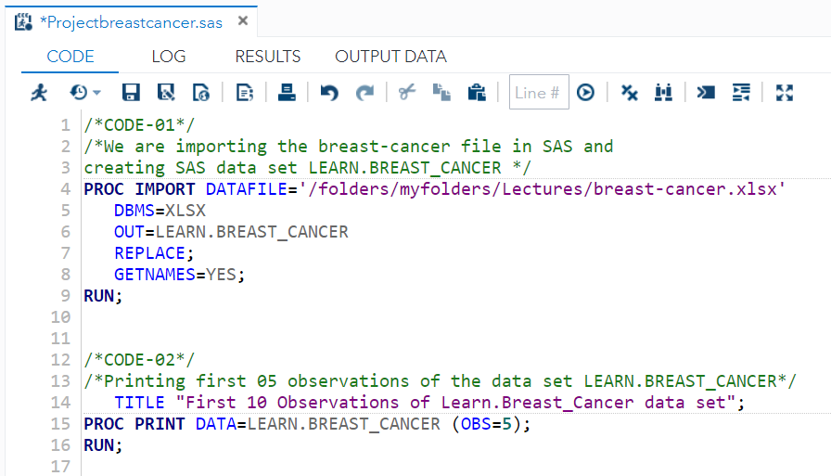
Analysis (Cont..)
Step – 1 Importing Breast Cancer file and create Data set

Slide 12
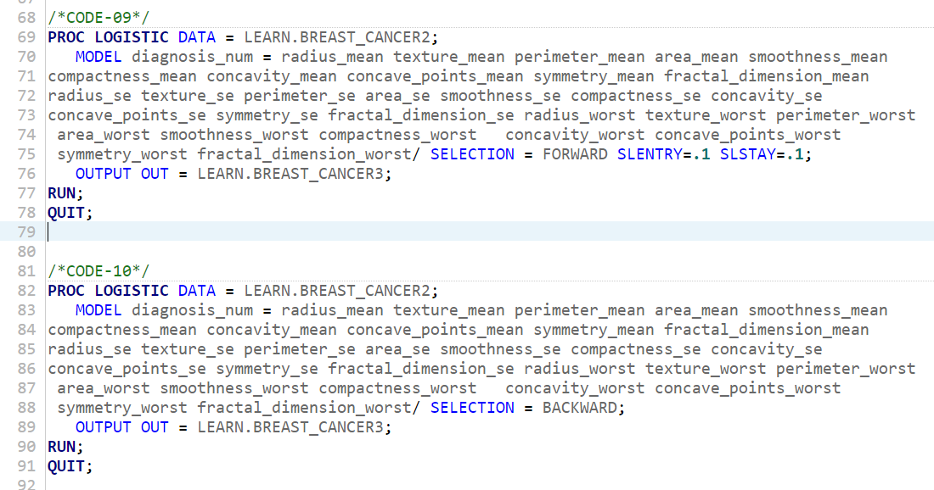
Step – 2 Deciding the Method of preparing Model on the basis of the characteristics of Targeted variable.
As Targeted variable Diagnosis is binary M= Malignant and B= Benign. We will go for Logistic Regression.
We need to use selection method to decide most significant independent variables out of 30 independent variables for our model building.

Slide 13
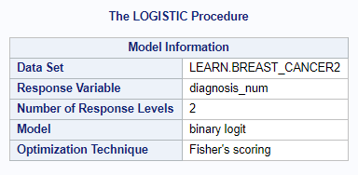
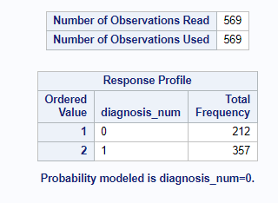
Analysis (Cont..)
We used both forward and stepwise selection method and found 7 most significant independent variables out of 30 for building the Logistic regression model.
Let’s discuss some of the output in detail to understand the analysis
Target variable ‘M’ or ‘B’
Optimization Technique – Fisher’s Scoring
Data set having 569 observations, out of which 212 have cancerous cells Malignant ‘M’ and 367 have non cancerous cells Benign ‘B’

Slide 14
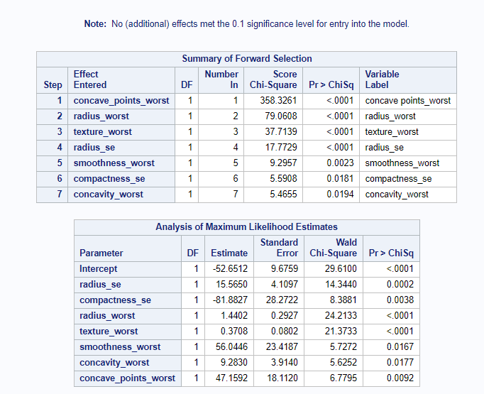
Step – 3(a) Let’s build model with 7 independent significant variables according to Forward and Stepwise selection method.
7 most significant independent variables.
All pValue <0.05 shows that they are significant but we saw the co-linearity between concavity_worst & concave_points_worst also we saw colinearity between radius_se & radius_mean so, we dropped concavity_worst and radius_worst from our final model.
This table shows maximum Likelihood, which means this 7 variables are the most suitable out of 30 independent variables for identifying variability in the diagnosis,
Or in simple word helpful to find the diagnosis value ‘M’ or ‘B’.

Slide 15
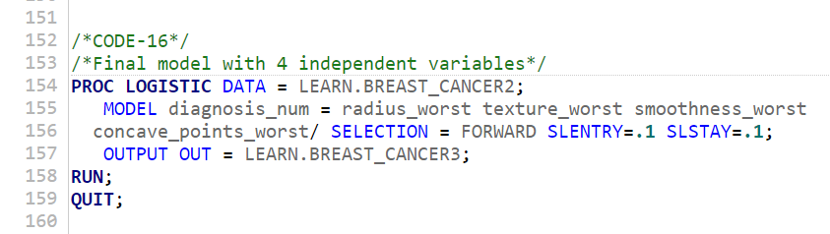
Step – 3(b) Our final model have 4 independent variables, we reduced 2 due to colinearity (concave_points_worst & radius_se) and then forward selection method dropped another one (compactness_se) as its pValue not remained significant in new combination. So, our final model have radius_worst, texture_worst, smoothness_worst and concave_points_worst variables.
Please keep this slide for attribution.

Slide 16
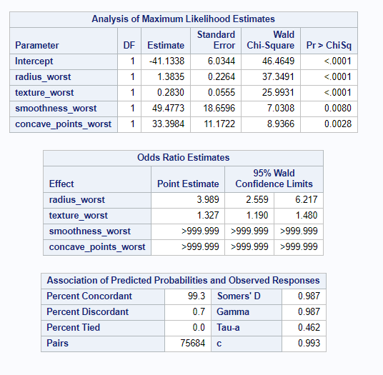
Analysis cont..
Our final binary logit model have 4 signififant independent variables.
radius_worst – In tumor distance of edge from centre.
Texture_worst – Grey scale value used to find tumor location.
Smoothness_worst-Shows variation in radious range.
and
Concave_point worst – it is highest mean value of the concabe portions of the contour.
c score is 0.993 which should be between 0 & 1 nearer to 1 is better model.
Percent concordant shows how many observations predicted correctly, 99.3% is exceptionally accurate performance.

Slide 17
Analysis cont..
So, we can conclude our analysis that model with 4 independent variables (radius_worst, texture_worst, smoothness_worst and concave_points_worst) is highly efficient and we should have combination of regular memmography, doctor’s diagnosis and prediction of our analytic model with this 3 filters we can catch the breast cancer at early stage and over come to it without any fatality.

Slide 18
03 Interpretation of Findings

Slide 19
Explanation of 4 independent variable affecting the diagnosis.
Radius_worst - It has the highest value of the center for the estimated range. It is essential to know the distance between the center and the point because surgery depends on the size. There is no chance to do surgery with big tumors
Texture_worst - The highest mean value of standard deviation for gray-scale values is shown as texture worst. Gray-scale is commonly used to find the tumor location, and the standard deviation is essential to find the variation of the data and to explain how to spread out the numbers.
Smoothness_Worst – It is the largest mean value for regional variation in radius range. Very important statistic to evaluate the growth of the tumor.
Concave_Point_Worst – It is the highest mean value of the concave portions of the contour, Contour depends on the volume of the breast and may be conisder 2mm,3mm or 5mm deep to see the concavity in the tumor.
Values of above 4 independent variables are accurate in diagnosing Malignant(M) or Benign(B) with about 99.3% c-score.

Slide 20
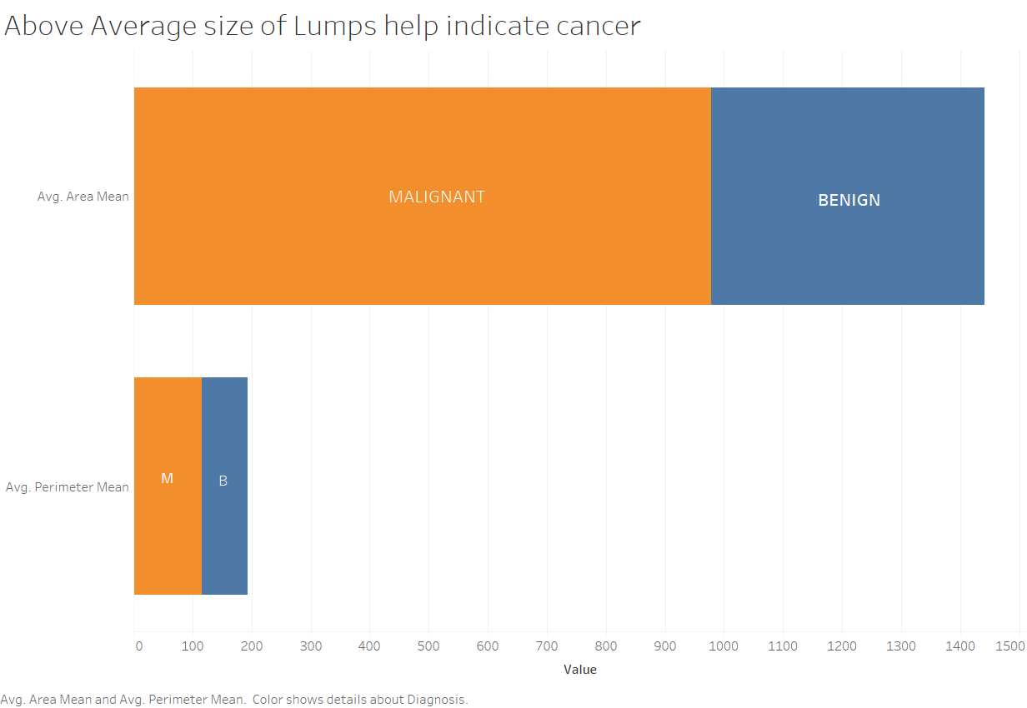

Slide 21
04 Recommendations

Slide 22
Recommendations
Regular mammograms can help find breast cancer at an early stage, when treatment is most successful. Women at high risk should have yearly mammograms along with an MRI starting at age 30.
There is a need to raise awareness on the importance of early screenings by working with all possible social, health and media organizations
Integrate technology, biology and risk models to improve existing infrastructure to better detect, treat and reduce possibility of recurrence.

Slide 23
Risk factors to consider are – Age, Personal or Family history, and Genetic factors, childbearing or menstrual history. Research shows that lifestyle changes can decrease the risk of breast cancer, even in women at high risk. To lower your risk. Key factors to consider are listed below:
Limit alcohol
Maintain a healthy weight
Daily physical activity
Do not smoke
Limit Sugar consumption
Eat a healthy diet
Maintain Bone health and take vitamin D

Slide 24
References
Breast Cancer Risk Assessment and Screening in Average-Risk Women. (2021). Retrieved 14 April 2021, from https://www.acog.org/clinical/clinical-guidance/practice-bulletin/articles/2017/07/breast-cancer-risk-assessment-and-screening-in-average-risk-women
(2021). Retrieved 14 April 2021, from https://www.ncbi.nlm.nih.gov/pmc/articles/PMC5176389/

